Slide 1
First steps with the OnDemand Toolbox
Introduction to the components

Slide 2




OD Toolbox components
OD Update
Update key-fields of documents in the OnDemand
OD Delete
Delete Documents from the OnDemand
OD Store
Archive Files directly into OnDemand
OD Filesystem Monitor
Monitors directories and automatically archives files using
preconfigured field-information and file types

Slide 3
OnDemand Toolbox
OD Update component

Slide 4
OD Update - HowTo
The interface of the OD Update component is similar to the OnDemand Client
There is no need for any configuration before use
Login
Update document
View document hitlist
Select a folder
View documents
Enter search criteria

Slide 5
OnDemand Toolbox
OD Delete component

Slide 6
OD Delete - HowTo
The interface of the OD Delete component is similar to the OnDemand Client
There is no need for any configuration before use
Login
Delete documents
View document hitlist
Select a folder
View documents
Enter search criteria

Slide 7
OnDemand Toolbox
OD Store component

Slide 8
OD Store - Configuration
The OD Store component needs to be configured before use:
Start the OD Store application, login to a server and click ‘Options’ > ‘Configuration’
The configuration window appears. You need to configure which file type (extension) should be archived using which Application and Application group for which folder
In the right part of the window you can select fields to mark them as mandatory

Slide 9
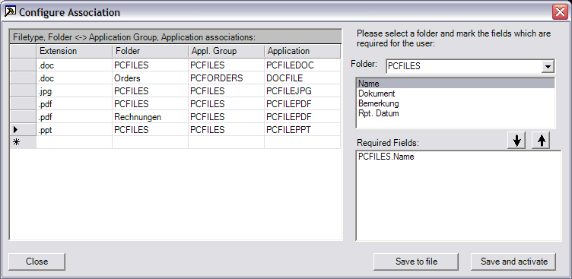
OD Store - Configuration
Enter the associations here.
Only filetypes / folders configured here
can be archived using OD Store
Choose a folder and select one or more fields to move them to the list below.
All fields in the list below will be marked as mandatory fields. The user will have to enter a value for this field.

Slide 10
OD Store - Configuration
Click this button to save the configuration
as a .REG file on your computer.
You can then install the configuration by
double-clicking on the .REG file.
You can send the file to other computers
for easy configuration transfers
Click this button to save the
configuration to your local computer.
This will have the same effect like
storing the configuration in a .REG
file and double-click on it.

Slide 11
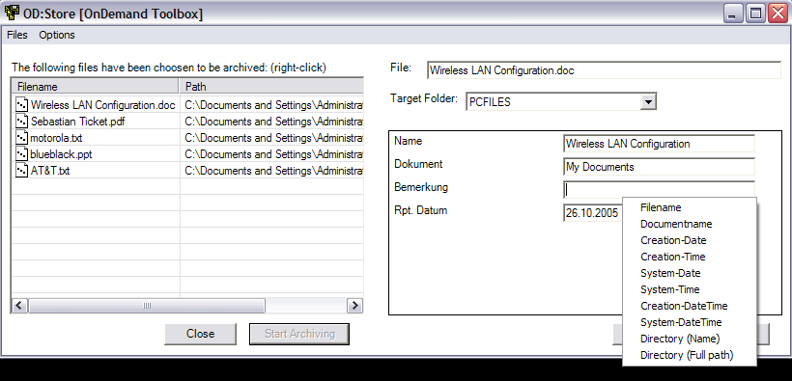
OD Store – How to the tool works
Right click to add files to the
list.These files will be archived.
Select the folder and
enter the values.
By right-clicking on a textbox a drop-down
menu appears. Select a index from the list.
Your selection will be maintained through all files

Slide 12
OnDemand Toolbox
OD Filesystem Monitor component

Slide 13
OD Filesystem Monitor – What is it all about
This component starts up with a window which lets you configure various aspects of the application.
You need to tell the monitor:
  Which directories should be monitored
  Which directory is the SUCCESS-Directory – The target for all successfully archived files
  Which is the ERROR-Directory – The target for all files which could not be archived successfully
  Which file types should be archived (along with which Application and which Application Group)
  What shall be done with unknown files (file types)
  Which Folder shall be used and how to set the keys

Slide 14
OD Filesystem Monitor – When it works
After having all details configured click ‘Start monitor’ to startup the monitor
The main window will hide. The monitor will work silently. You can see its results in the OnDemand and in your filesystem
All action can be seen in the log
  Access the log by right-clicking on the icon in the systray when the monitor is running
  or by hitting F3 when you are in the main window

